Slide 1
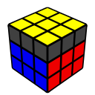
Solving the Cube – Pt. 3
Michael George
WCA ID: 2015GEOR02

Slide 2
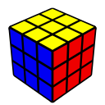
The Last Layer
Last Layer (LL) consists of 2 steps
Orientation (OLL) – Edge Orientation (EOLL) + Corner Orientation (OCLL)
Permutation (PLL) – Corner Permutation (CPLL) + Edge Permutation (EPLL)
Trivia – Your cube is likely to be unsolvable if disassembled and randomly reassembled!
The probability that your cube can be solved after being randomly reassembled is 1/12
You will only realise your cube is unsolvable whilst trying to solve the last layer
There are three possible causes of an unsolvable cube
EOLL “parity” – e.g. Flipped edge – 1/2 chance of being correct
OCLL “parity” – e.g. Twisted corner – 1/3 chance of being correct
PLL “parity” – e.g. Two edges or corners swapped – 1/2 chance of being correct

Slide 3
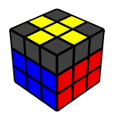

Orientation of the Last Layer (OLL)
Approach
Orientation of the Last Layer (OLL) will be broken into in two sub-steps
Edge Orientation of the Last Layer (EOLL)
Orienting Corners of the Last Layer (OCLL)
Manipulation of the F2L can be used to change the orientation of the last layer
e.g. Extracting an F2L pair then re-inserting it using a different “trigger”
This approach requires two simple “algorithms” which are essentially combinations of “triggers”
Algorithm for edge orientation (EOLL) – F R U moves
Algorithm for corner orientation (OCLL) – R U moves

Slide 4
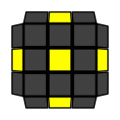
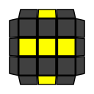
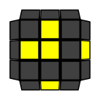
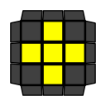
Edge Orientation of the Last Layer (EOLL)
There are 4 possible cases during EOLL including the “solved” case
Cases: There can only be 2 or 4 “flipped” edges. An odd number of “flipped” edges cannot be solved!
Probabilities: The “adjacent edge flip” is the most common EOLL at 4/8 solves (i.e. 50% of the time)
Approach: A single algorithm can be used to cycle through the EOLL cases
1/8
2/8
4/8
1/8

Slide 5
EOLL Algorithm
To change the orientation of edges you must use a mixture of F R U moves
The EOLL algorithm that will be used is F (U R U’ R’) F’
Notice how it includes the U R U’ R’ trigger that was used during F2L
The F is referred to as a “setup” move and the F’ will undo the setup
The algorithm “flips” two LL edges (UF and UR) but it also has a side effect of “permuting” LL edges and corners
Explanation of the algorithm
The F move is turning the front layer to create a “pseudo slot” at the front-right of the F2L
The U R U’ R’ trigger exchanges pieces between the U-layer and the “pseudo slot”
The F’ move restores the front layer and thus the F2L
Setup for the algorithm
The key to using this algorithm is knowing the appropriate “setup” prior to execution

Slide 6
EOLL Demonstration
There are 4 possible cases during EOLL including the “solved” case
Approach: “Dot case” -> “opposite edge flip” -> “adjacent edge flip” -> “solved”
Setup: Ensure the “adjacent edge flip” is showing “nine o’clock” before executing the EOLL algorithm
Algorithm: F (U R U’ R’) F’ – once, twice or thrice
e.g.
Dot
Opposite
Adjacent
Solved

Slide 7
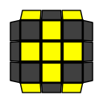
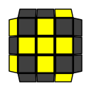
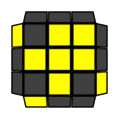
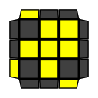
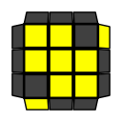
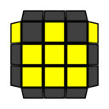
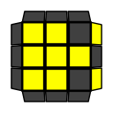
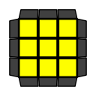
Orienting Corners of the Last Layer (OCLL)
There are 8 possible cases during OCLL including the “solved” case
2/27
4/27
4/27
4/27
4/27
4/27
4/27
1/27

Slide 8
Orienting Corners of the Last Layer (OCLL)
OCLL can be solved by cycling through the cases in a similar fashion to EOLL
Cases: There can only be 2, 3 or 4 “twisted” corners, corresponding to the images on the previous slide
Probabilities: Most of the OCLL cases have a probability of 4/27
Approach: Cycle from 2 twisted corners or 4 twisted corners -> 3 twisted corners -> “solved”
e.g.
L / Bowtie
Sune
Anti-Sune
Solved

Slide 9
OCLL Algorithm
To affect the orientation of corners on the last layer you only need to use R U moves
The OCLL algorithm that will be used is a combination of two triggers – (R U2 R’ U2’) (U R U’ R’)
The R U2 R’ U2’ trigger extracts the front-right F2L pair
The U R U’ R’ trigger re-inserts the front-right F2L pair
The algorithm will “twist” three LL corners but it also has a side effect of “permuting” LL edges
Note: The algorithm can be shortened to R U2 R’ U’ R U’ R’ due to a “cancellation” between the triggers
Explanation of the algorithm
The algorithm extracts an F2L pair using the R U2 R’ U2’ trigger and re-inserts it using the U R U’ R’ trigger
It is worth noting that any algorithm consisting solely of R U moves will not affect edge orientation (EO)
Setup for the algorithm
The key to using this algorithm is knowing the appropriate “setup” prior to execution
The setup is based on simple rules based on the number of ”twisted” corners – see the following slides

Slide 10
3 Twisted Corners
There are 2 OCLL cases with 3 twisted corners
Approach: “Sune” -> “Anti-Sune” -> “Solved”
Setup: Ensure the “oriented” corner is at the back-right (see arrows) before executing the OCLL algorithm
Algorithm: (R U2 R’ U2’) (U R U’ R’) – once or twice, remembering to AUF prior to execution
Sune
Anti-Sune
Solved

Slide 11

4 Twisted Corners
There are 2 OCLL cases with 4 twisted corners
Approach: “H / Double Sune” or “Pi / Bruno” -> “Anti-Sune” -> “Solved”
Setup: Ensure the back-right corner has its U-sticker on the back before executing the OCLL algorithm
Algorithm: (R U2 R’ U2’) (U R U’ R’) – twice, remembering to AUF prior to execution
or
H / Double Sune
Pi / Bruno
Anti-Sune
Solved

Slide 12
2 Twisted Corners
There are 3 OCLL cases with 2 twisted corners and they take the most effort to solve
Approach: “L / Bowtie” or “T / Chameleon” or “U / Headlights” -> “Sune” -> “Anti-Sune” -> “Solved”
Setup: Ensure the back-right corner has its U-sticker on the right before executing the OCLL algorithm
Algorithm: (R U2 R’ U2’) (U R U’ R’) – thrice, remembering to AUF prior to execution
or
or
...
L / Bowtie
T / Chameleon
U / Headlights
Sune

Slide 13
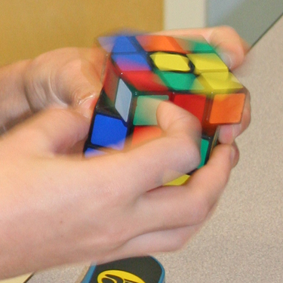
Finger Tricks
F (U R U’ R’) F’
Use your index finger(s) to turn the U-layer for the “setup” instead of rotating the cube around the y-axis
Re-grip so that your right thumb is underneath the R-face and fingers are on top before executing the algorithm
The F move should be executed with your right index finger, pushing the top-right corner downwards
Re-grip before executing the U R U’ R’ trigger which in itself should not require any further re-grips
The F’ move should be executed with your right thumb, pushing the bottom-right corner upwards
(R U2 R’ U2’) (U R U’ R’)
Use your index finger(s) to turn the U-layer for the “setup”
Re-grip so that your right thumb is underneath the R-face and fingers are on top
Execute the whole algorithm without re-gripping
The U2 can be executed as a “double flick” – i.e. index finger followed by middle finger

Slide 14
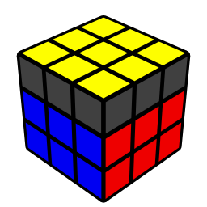

Nearly Done!

